Slide 1
CSE327 Software Engineering
AKM iqtidar Newaz [IqN]
Lecture - 14

Slide 2
Adapter Design Pattern
Example 1: Power Adapter and Socket
Existing Interface /
Adapter
Two Pin
Power Adapter
Socket
Client
Bridge
Want to use but
incompatible

Slide 3
Adapter Design Pattern
Example 2: User wants to see weight in KG:
Adapter
100 lb
Existing Interface /
Adapter
Client
Convert
lb to kg

Slide 4
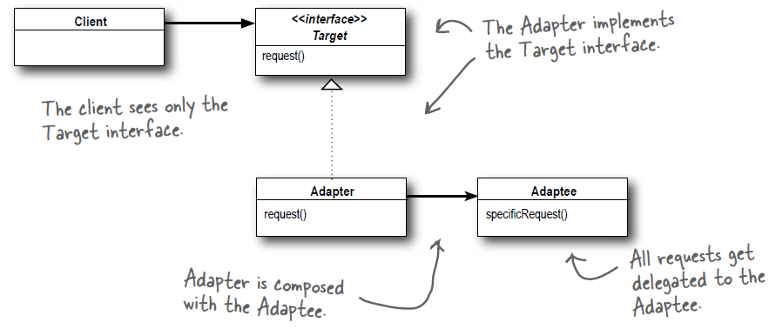
Adapter Design Pattern (Structural Design Pattern)
The Adapter Pattern converts the interface of a class into another interface the clients expect.
Adapter lets classes work together that couldn’t otherwise because of incompatible interfaces.

Slide 5
Adapter Design Pattern (Structural Design Pattern)
#pragma once
#include "duck.h"
#include <iostream>
using namespace std;
class MallardDuck : public Duck
{
public:
void quack() override
{
cout << "Quack" << endl;
}
void fly() override
{
cout << "I am flying" << endl;
}
};
mallardDuck.h
#pragma once
class Duck
{
public:
virtual ~Duck() = default;
virtual void quack() = 0;
virtual void fly() = 0;
};
duck.h

Slide 6
Adapter Design Pattern (Structural Design Pattern)
#pragma once
#include "turkey.h"
#include <iostream>
using namespace std;
class WildTurkey : public Turkey
{
public:
void gooble() override
{
cout << "Googble, gooble" << endl;
}
void fly() override
{
cout << "I am flying a short distance" << endl;
}
};
wildTurkey.h
#pragma once
class Turkey
{
public:
virtual ~Turkey() = default;
virtual void gooble() = 0;
virtual void fly() = 0;
};
turkey.h

Slide 7
Adapter Design Pattern (Structural Design Pattern)
#pragma once
#include "duck.h"
#include "turkey.h"
#include <iostream>
#include <random>
#include <ctime>
using namespace std;
class DuckAdapter : public Turkey
{
public:
DuckAdapter(Duck *du) : duck(du), randGen(std::random_device{}()), dist(0, 4) {}
void gooble() override
{
duck->quack();
}
void fly() override
{
if (dist(randGen) == 0) // Corrected function call
duck->fly();
}
private:
Duck *duck;
std::mt19937 randGen; // Mersenne Twister RNG
std::uniform_int_distribution<int> dist; // Uniform distribution
};
#pragma once
#include "turkey.h"
#include "duck.h"
#include <iostream>
using namespace std;
class TurkeyAdapter : public Duck
{
public:
TurkeyAdapter(Turkey *tur) : turkey(tur) {}
void quack() override
{
turkey->gooble();
}
void fly() override
{
for (int i = 0; i < 5; i++)
{
turkey->fly();
}
}
private:
Turkey *turkey;
};
duckAdapter.h
turkeyAdapter.h

Slide 8
Adapter Design Pattern (Structural Design Pattern)
#include "turkeyAdapter.h"
#include "duckAdapter.h"
#include "mallardDuck.h"
#include "wildTurkey.h"
#include <iostream>
using namespace std;
void testDuck(Duck *duck)
{
duck->quack();
duck->fly();
}
void testTurkey(Turkey *turkey)
{
turkey->gooble();
turkey->fly();
}
int main()
{
Duck *duck = new MallardDuck();
Turkey *turkey = new WildTurkey();
cout << "The Duck says..." << endl;
testDuck(duck);
cout << "The Turkey says..." << endl;
testTurkey(turkey);
cout << "\nTurkey Adapter Performing\n";
Duck *turkeyAdapter = new TurkeyAdapter(turkey);
testDuck(turkeyAdapter);
cout << "\nDuck Adapter Performing\n";
Turkey *duckAdapter = new DuckAdapter(duck);
testTurkey(duckAdapter);
}
Output:
The Duck says...
Quack
I am flying
The Turkey says...
Googble, gooble
I am flying a short distance
Turkey Adapter Performing
Googble, gooble
I am flying a short distance
I am flying a short distance
I am flying a short distance
I am flying a short distance
I am flying a short distance
Duck Adapter Performing
Quack
I am flying
main.cpp
main.cpp

Slide 9
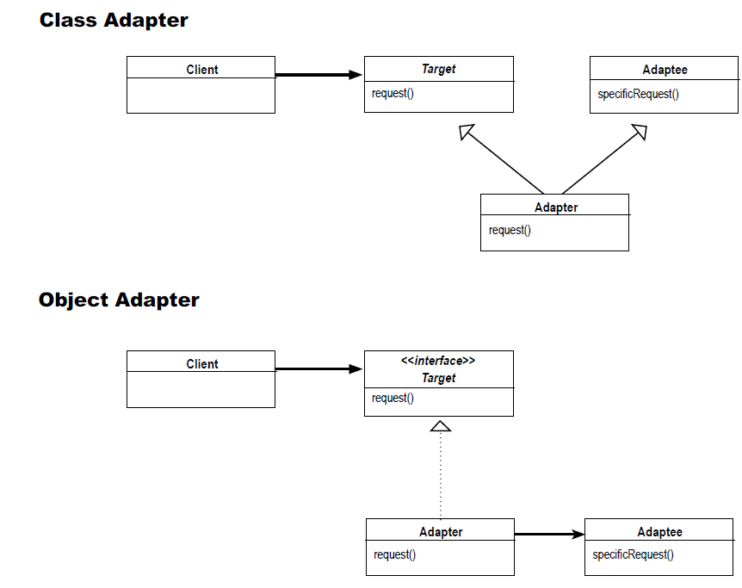
Different Types of Adapter

Slide 10
Class Adapter: Example
duck.h
#pragma once
#include "duck.h"
#include <iostream>
using namespace std;
class MallardDuck : public Duck
{
public:
void quack() override
{
cout << "Quack" << endl;
}
void fly() override
{
cout << "I am flying" << endl;
}
};
mallardDuck.h
#pragma once
class Duck
{
public:
virtual ~Duck() = default;
virtual void quack() = 0;
virtual void fly() = 0;
};

Slide 11
Class Adapter: Example
#pragma once
class Turkey
{
public:
virtual ~Turkey() = default;
virtual void gobble() = 0;
virtual void fly() = 0;
};
#pragma once
#include "turkey.h"
#include <iostream>
using namespace std;
class WildTurkey : public Turkey
{
public:
void gobble() override
{
cout << "Gobble, Gobble" << endl;
}
void fly() override
{
cout << "I am flying a short distance" << endl;
}
};
turkey.h
wildTurkey.h

Slide 12
Class Adapter: Example
#pragma once
#include "duck.h"
#include "turkey.h"
#include "mallardDuck.h"
#include <random>
#include <ctime>
class MallardDuckAdapter : public Turkey, private MallardDuck
{
public:
MallardDuckAdapter() = default;
void gobble() override
{
MallardDuck::quack();
}
void fly() override
{
if (dist(randGen) == 0) // Corrected function call
MallardDuck::fly();
}
private:
std::mt19937 randGen; // Mersenne Twister RNG
std::uniform_int_distribution<int> dist; // Uniform distribution
};
mallardDuckAdapter.h

Slide 13
Class Adapter: Example
#pragma once
#include "duck.h"
#include "wildTurkey.h"
#include <iostream>
using namespace std;
class WildTurkeyAdapter : public Duck, private WildTurkey
{
public:
WildTurkeyAdapter() = default;
void quack() override
{
WildTurkey::gobble();
}
void fly() override
{
for (int i = 0; i < 5; i++)
{
WildTurkey::fly();
}
}
};
wildTurkeyAdapter.h

Slide 14
Class Adapter: Example
#include "wildTurkey.h"
#include "wildTurkeyAdapter.h"
#include "mallardDuck.h"
#include "mallardDuckAdapter.h"
#include <iostream>
using namespace std;
void testDuck(Duck *duck)
{
duck->quack();
duck->fly();
}
void testTurkey(Turkey *turkey)
{
turkey->gobble();
turkey->fly();
}
int main()
{
Turkey *turkey = new WildTurkey();
cout << "The Turkey says: " << endl;
turkey->gobble();
turkey->fly();
cout << "\nTurkeyAdapter is coming:\n";
Duck *wildTurkeyAdapter = new WildTurkeyAdapter();
testDuck(wildTurkeyAdapter);
cout << "\nDuckAdapter is coming:\n";
Turkey *duck = new MallardDuckAdapter();
testTurkey(duck);
}
Output:
The Turkey says:
Gobble, Gobble
I am flying a short distance
TurkeyAdapter is coming:
Gobble, Gobble
I am flying a short distance
I am flying a short distance
I am flying a short distance
I am flying a short distance
I am flying a short distance
DuckAdapter is coming:
Quack

